Slide 1
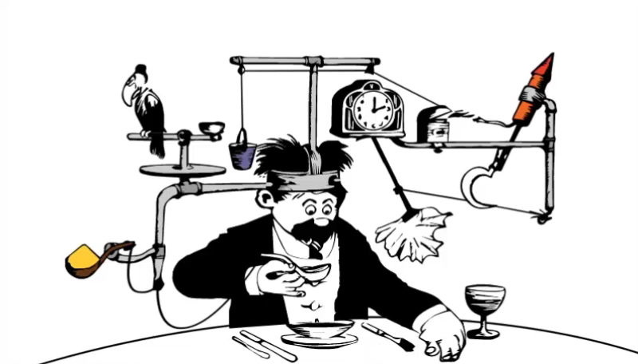
The Rube Goldberg Project
HTTP://WWW.RUBEGOLDBERG.COM

Slide 2
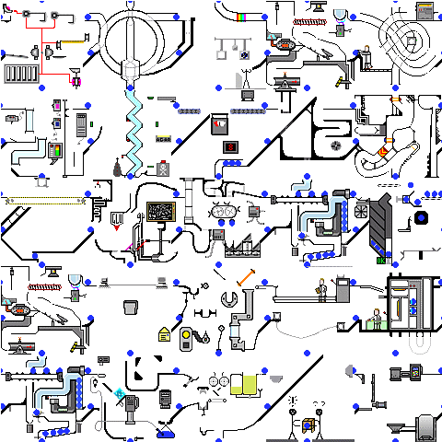
Why do a building project?
Fun!
Teach students about the concepts in a very hands on way.
Teach students how to use tools, shop at the hardware store and build things with their hands!
Teach the engineering design process and problem solving skills.

Slide 3
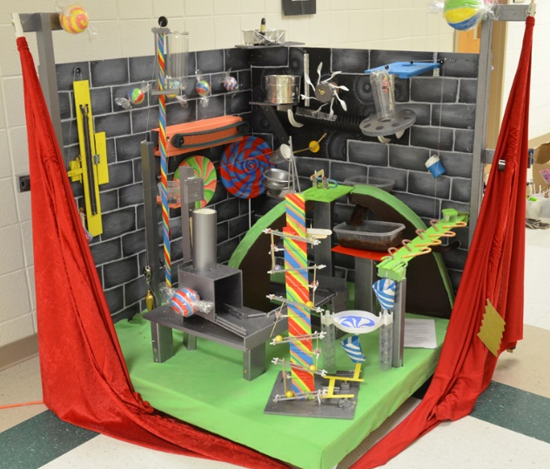
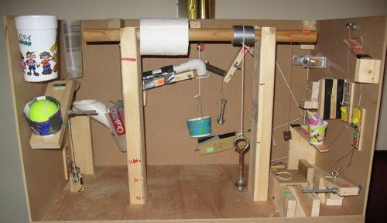
The Project
Design, build, test and document a device that completes a required final task through a sequence of consecutive events.
# of tasks
Specific Required tasks
Required task types (electrical, mechanical, thermal …)
Required energy exchanges (e.g. electrical to mechanical)
Requiring tasks that display topics learned in class (1 per unit)
Optional/extra credit tasks
Required time (timing steps)
Require groups to work together to create connections between their steps or devices.

Slide 4
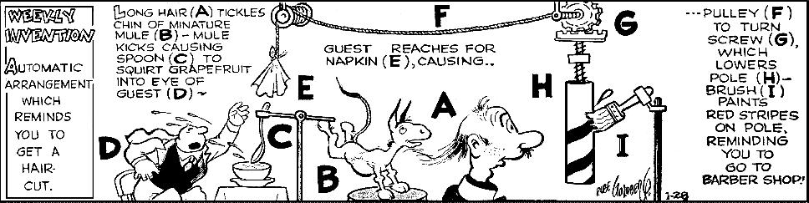
How to get started
Students research Rube Goldberg machines and bring favorite videos to show in class.
Students pick favorite task from each video and write about it.
Research 6 simple machines.
Create preliminary design on paper.
Start collecting “stuff”

Slide 5
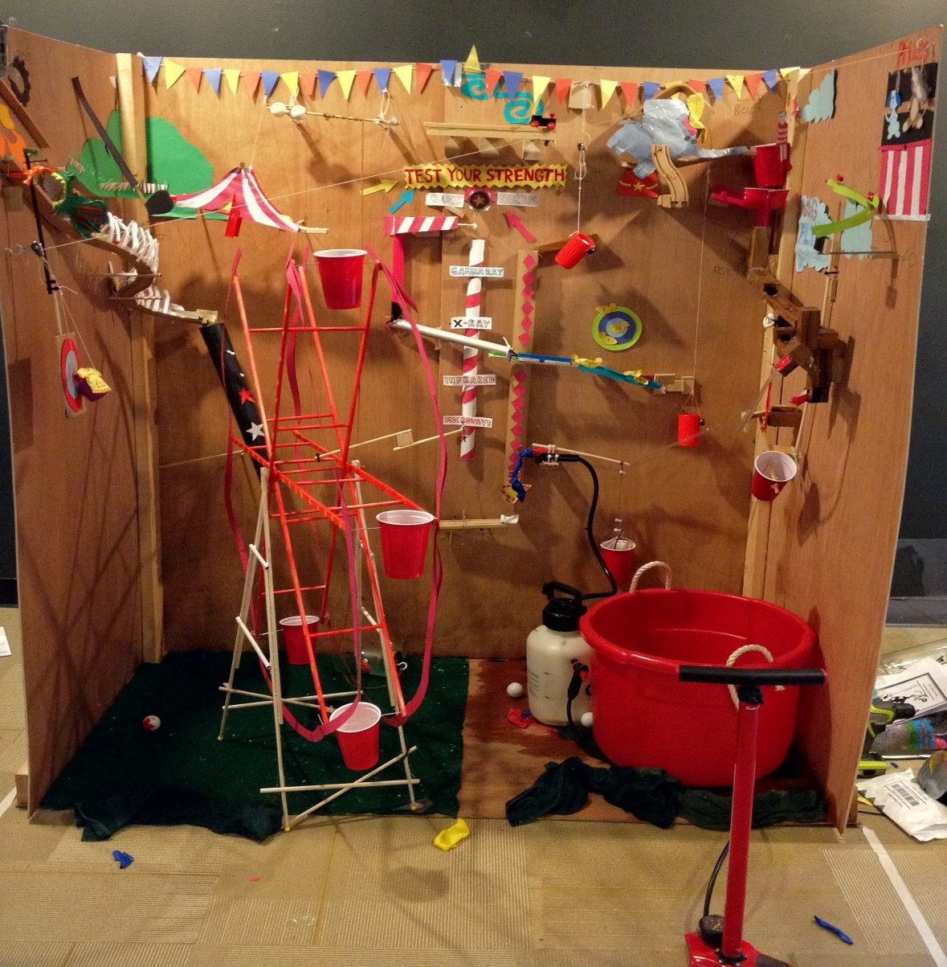
Logistics
In class or at home (or a hybrid)
Where to collect materials
What size can the project be?
How to attach the steps to a base (or box)

Slide 6
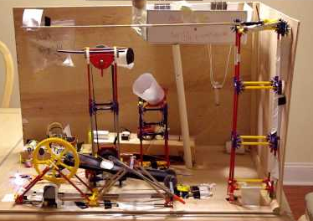
Grading
Pre-build research
Pre-build designs and task sequence lists
Descriptions of the physics involve in steps
Task sequence lists
The testing of the device
  Does it include required elements
  Did students touch a step to make it run?
  Did students touch the device to bypass a step?
  Required run time.

Slide 7
